Slide 1

How is the data in a CPACS file structured?
M. Alder
Institute of System Architectures in Aeronautics
Aircraft Design & System Integration

Slide 2
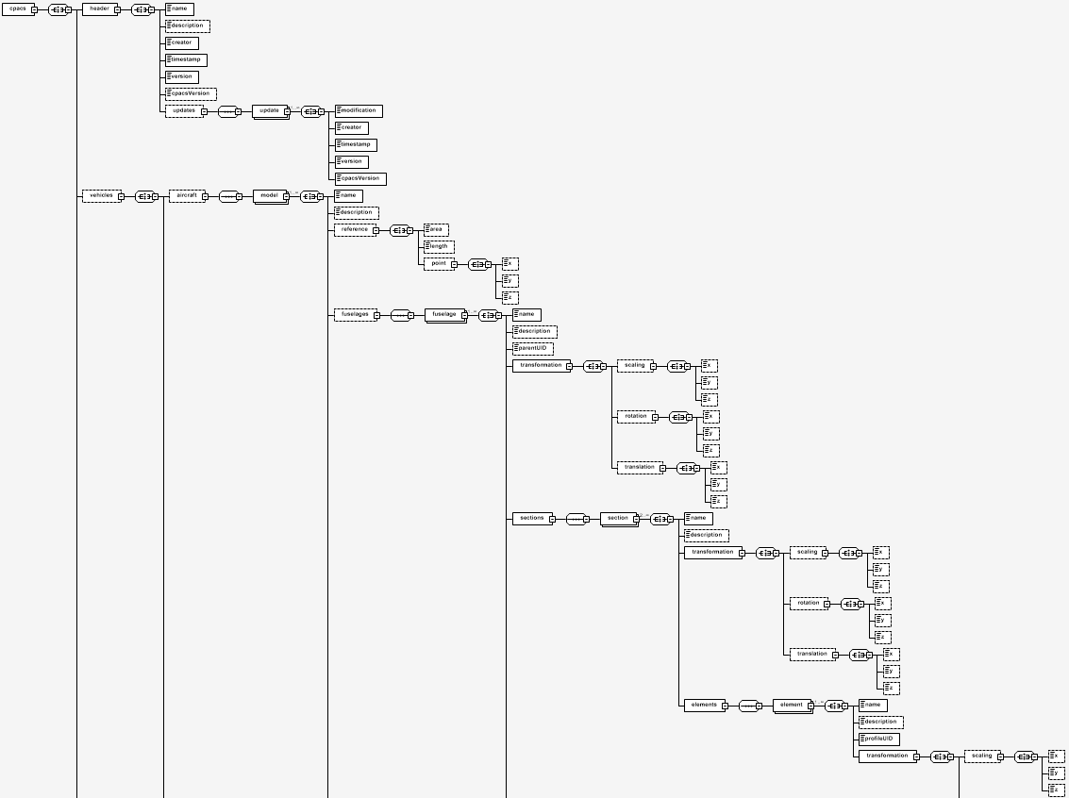
Schema Visualization

Slide 3
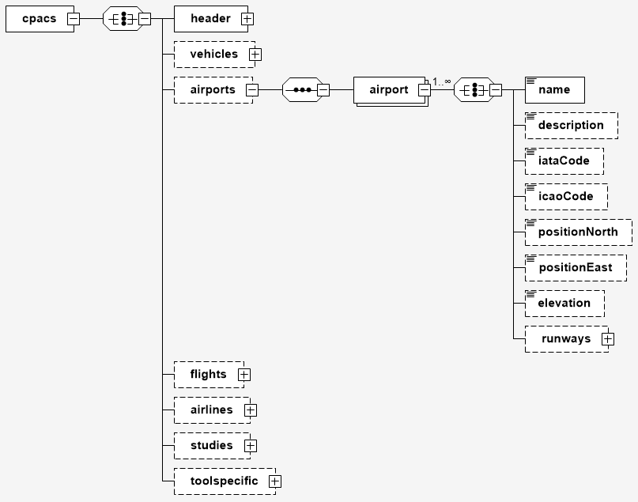
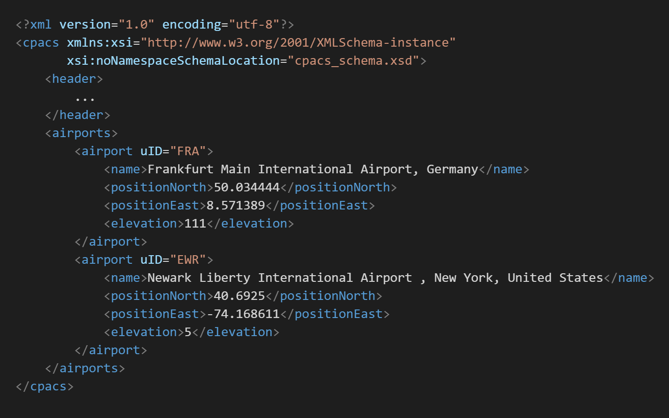
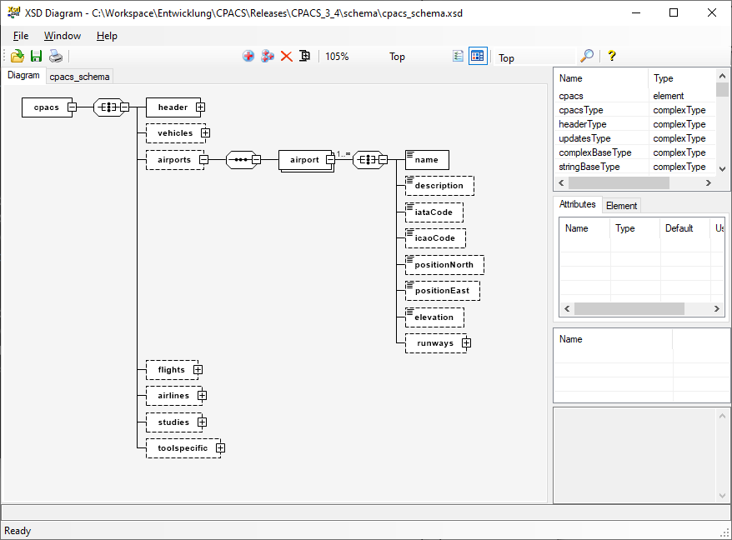
http://regis.cosnier.free.fr/?page=XSDDiagram

Slide 4
[1..1]
[0..1]
[1..∞]
http://regis.cosnier.free.fr/?page=XSDDiagram

Slide 5
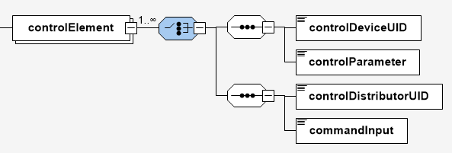
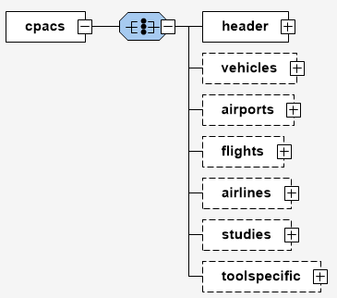
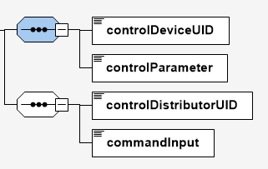
xsd:choice
xsd:sequence
xsd:all

Slide 6
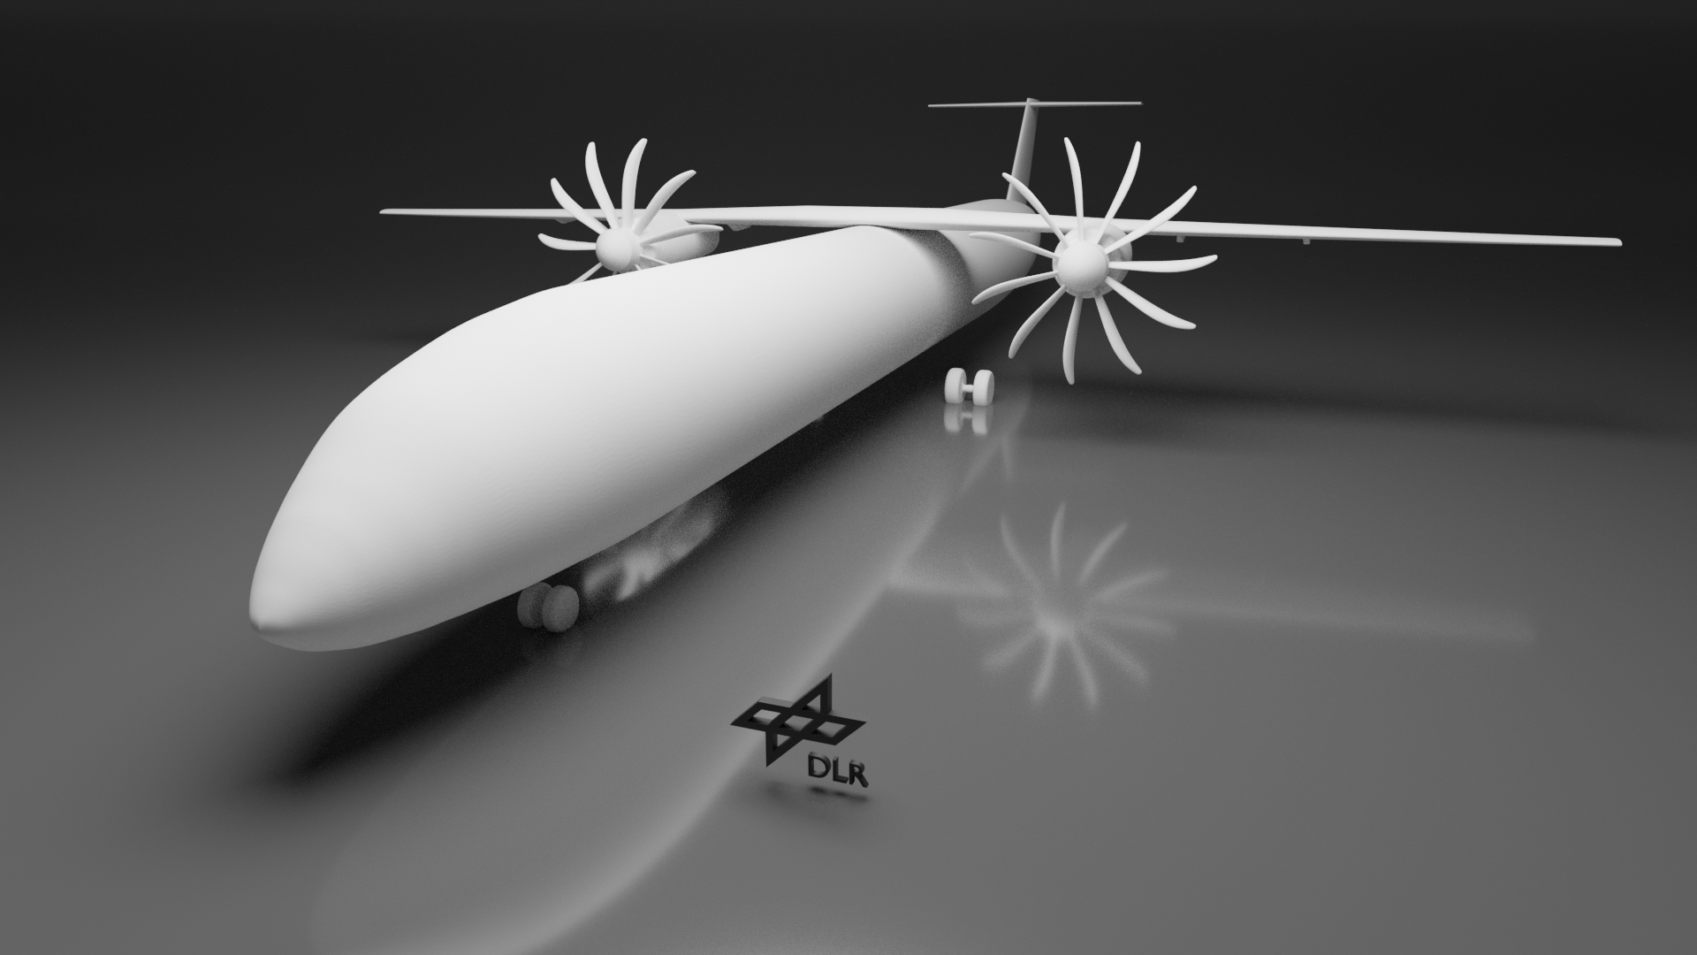
Data structure

Slide 7
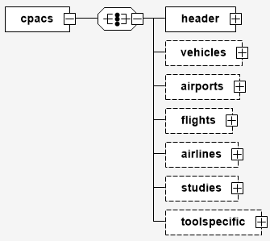

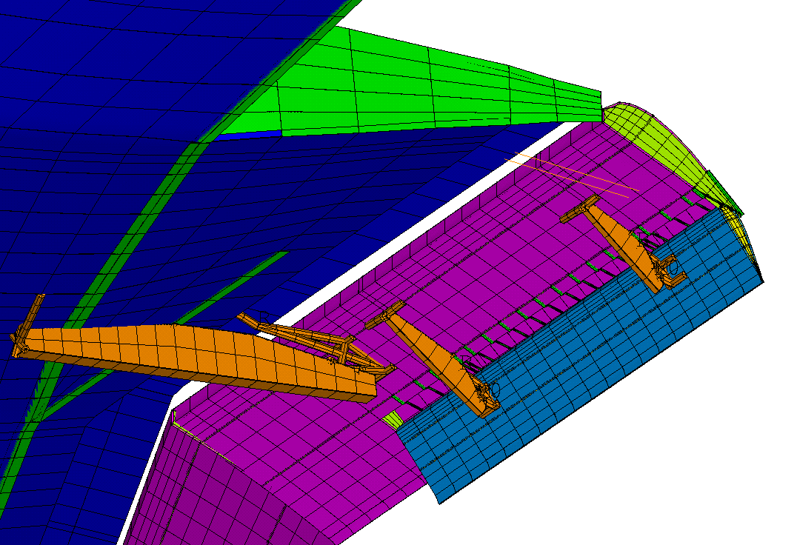
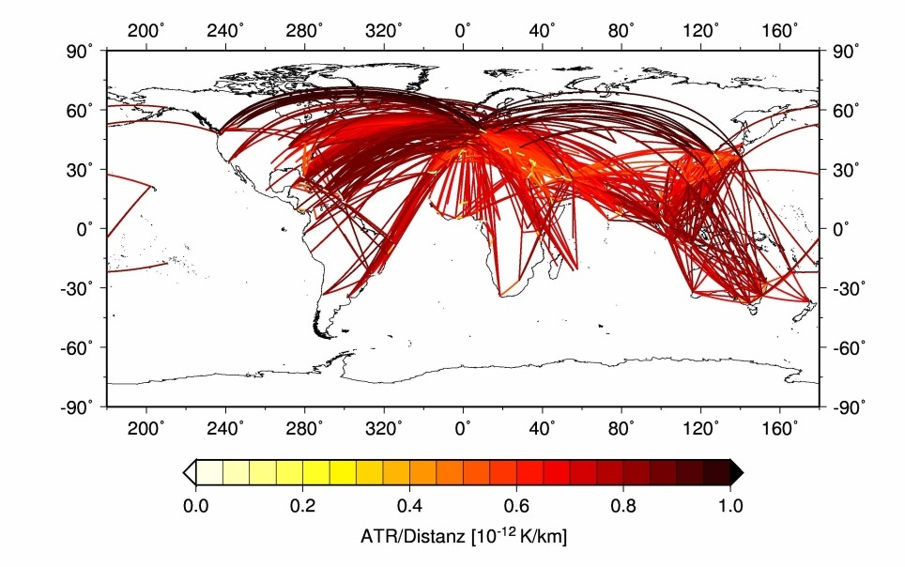

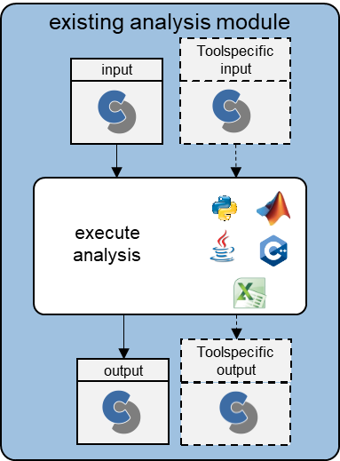


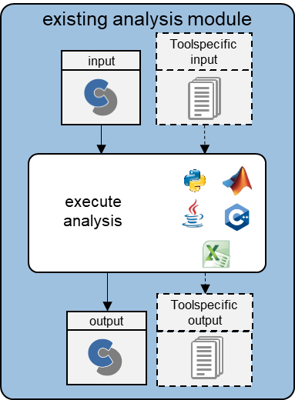



Provenance
existing analysis module
Toolspecific input
input
execute analysis
output
Toolspecific output

Slide 8
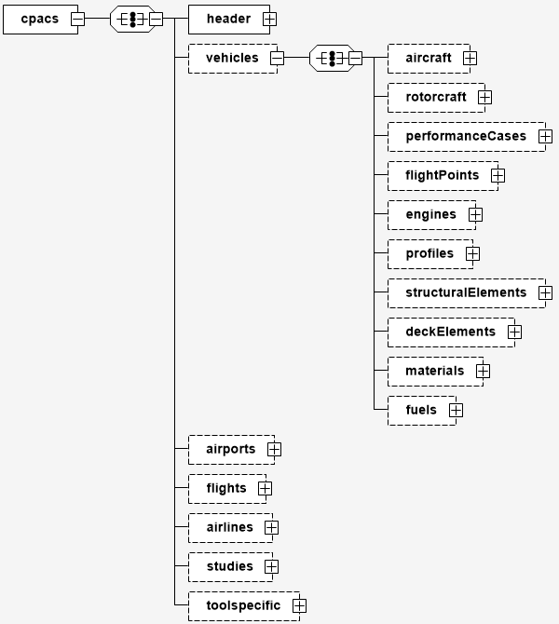
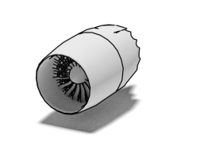
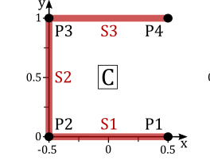
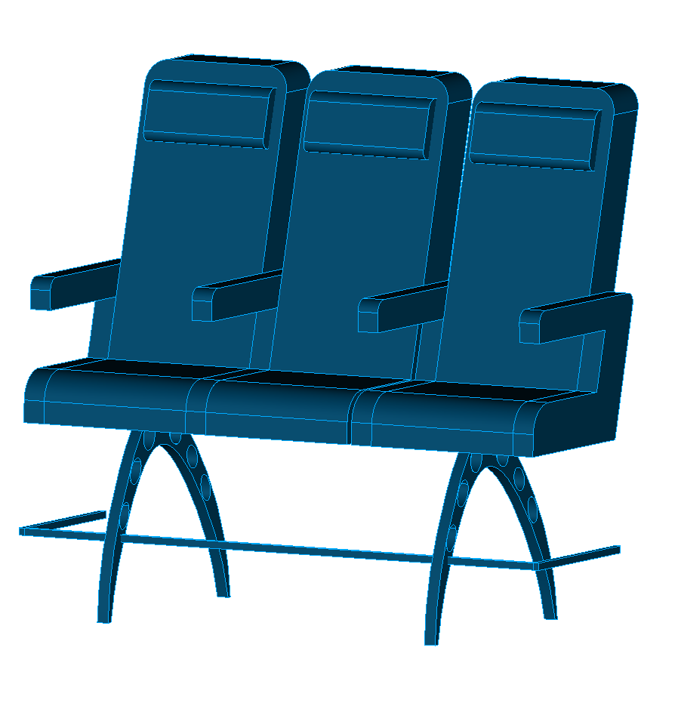
vehicle instances
vehicle independent performance requirements
vehicle independent library elements

Slide 9
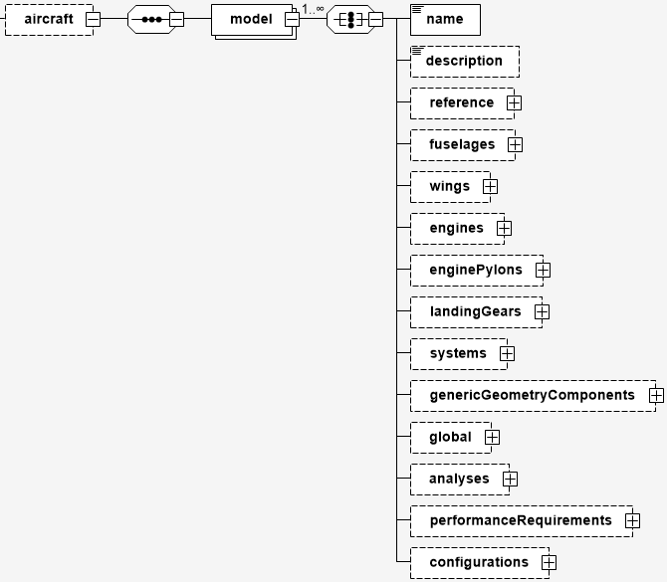
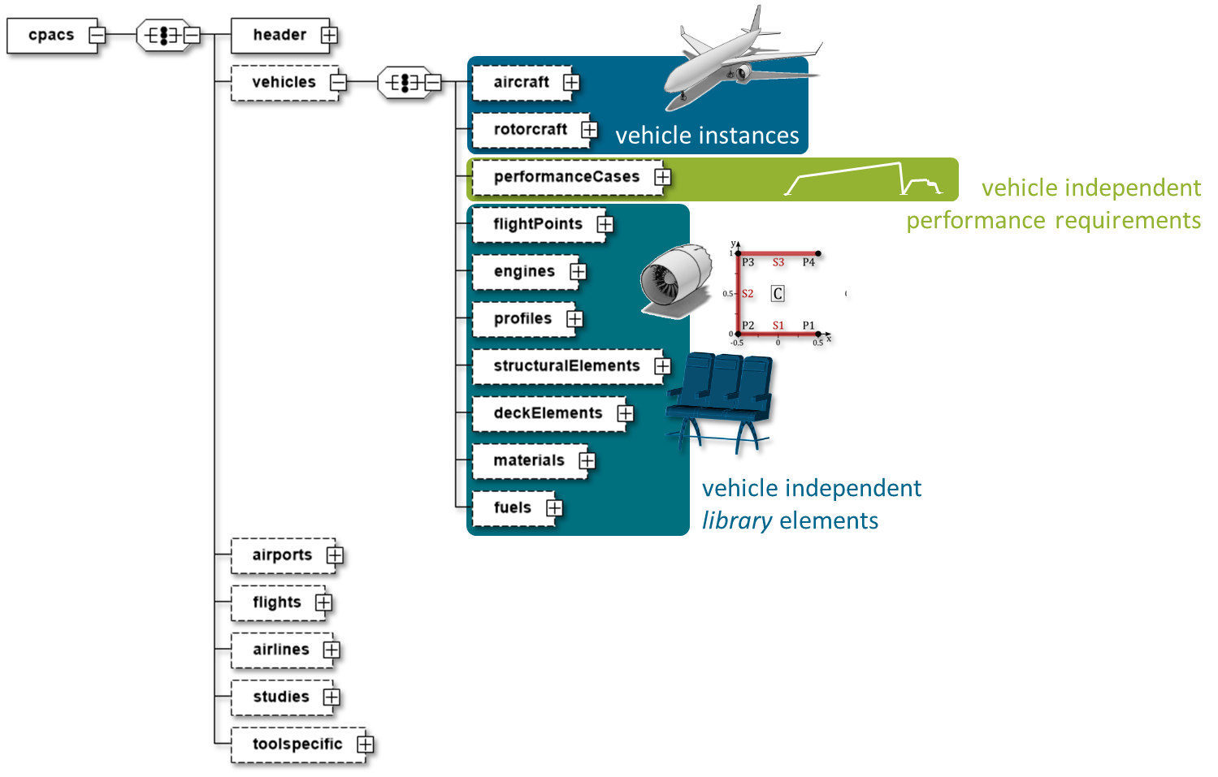
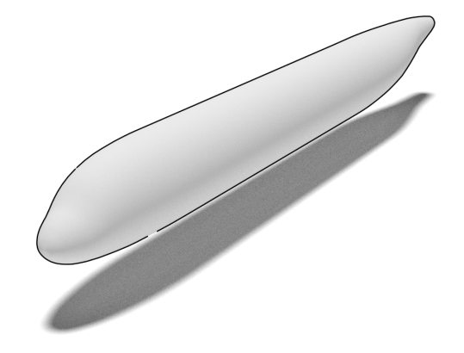
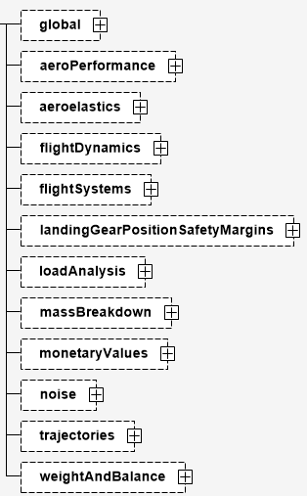

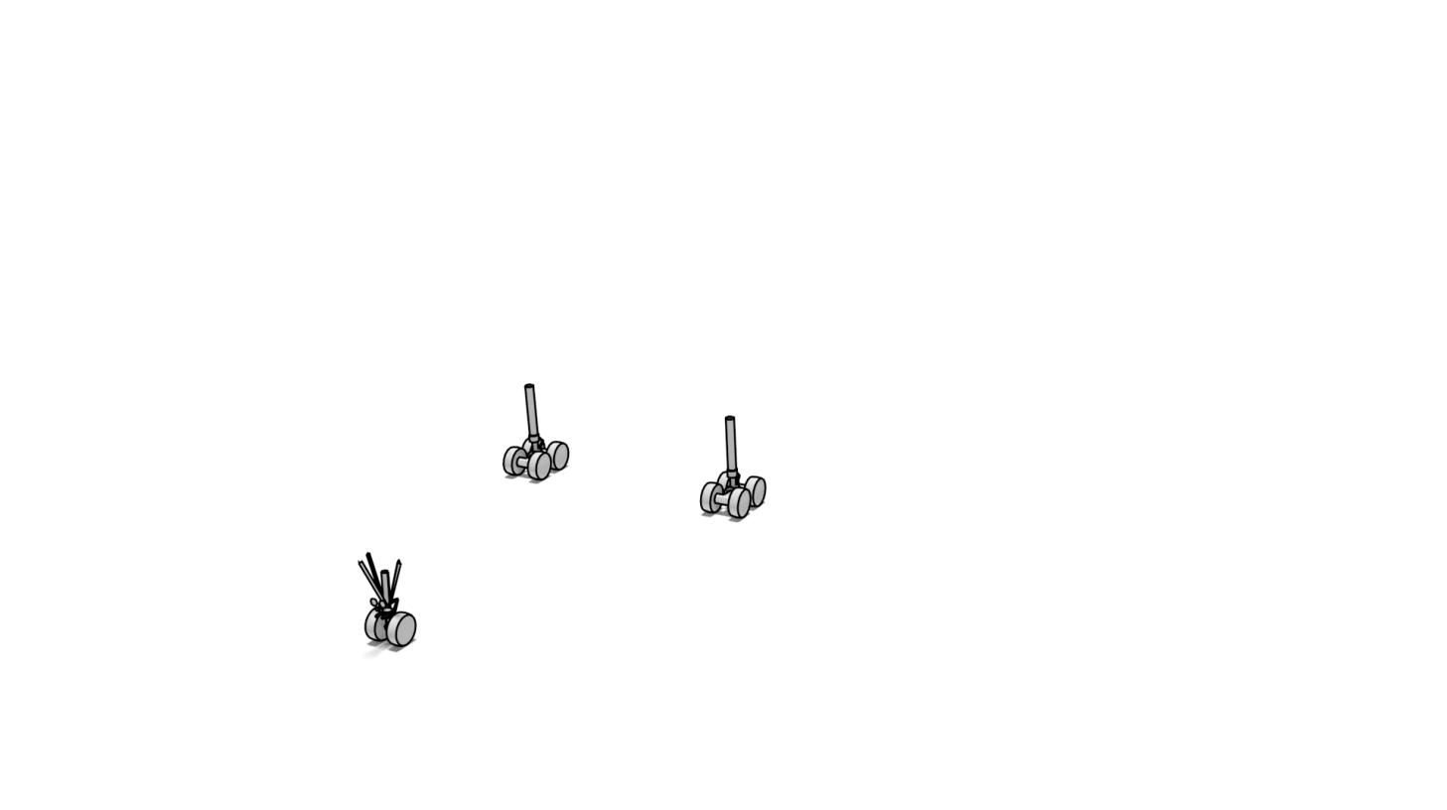

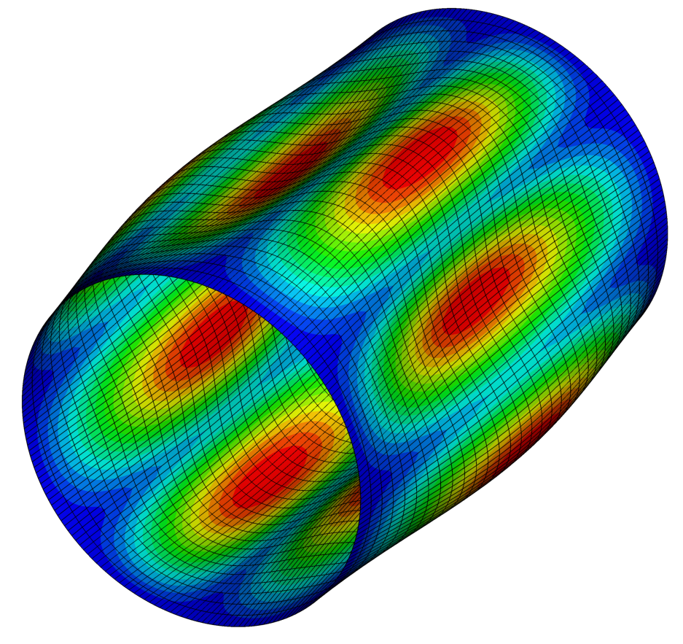
vehicle specific delements:
geometry
uID
study results
settings

Slide 10


Credit notes
Topic: How is the data in a CPACS file structured?
Date: 15 Mai 2023
Autor: Marko Alder
Institut: DLR Institute of System Architectures in Aeronautics
Credits: DLR
 www.cpacs.de
 cpacs@dlr.de

